Slide 1
Session 12 - Personal
MIS 6311-501 Cyber Security Fundamentals
Chris Davis

Slide 2
Housekeeping
Any Questions? Please do not hesitate to email. Or text.
Class Website: https://elearning.utdallas.edu
Dropbox: https://goo.gl/9AFyoE
UTD Email: cmd140430@utdallas.edu
Gmail: davischr2@gmail.com
Google Voice: 214-771-8122 (Text & Emergencies)
LinkedIn: www.LinkedIn.com/in/ChristopherDavis
Blog: www.cloudauditcontrols.com
Class: Monday 7:00pm-9:45pm JSOM 12.210

Slide 3
Academic Calendar & Sessions

Slide 4
Comparison of Our Class to CISSP Domains
Shon Harris Book – Chapters
Current CISSP Domains
2
Information Security Governance and Risk Management
8
Business Continuity and Disaster Recovery Planning
Security and Risk Management
9
Legal, Regulations, Investigations and Compliance
7
Cryptography
Security Engineering
4
Security Architecture and Design
Security Assessment and Testing
5
Physical (Environmental) Security
Asset Security
6
Telecommunications and Network Security
Communications and Network Security
3
Access Control
Identity and Access Management
11
Operations Security
Security Operations
10
Software Development Security
Software Development Security

Slide 5
PROJECT PRESENTATIONS

Slide 6
Tales from the Crypt.
Practical Applications & Lessons Learned.

Slide 7
MODELS

Slide 8
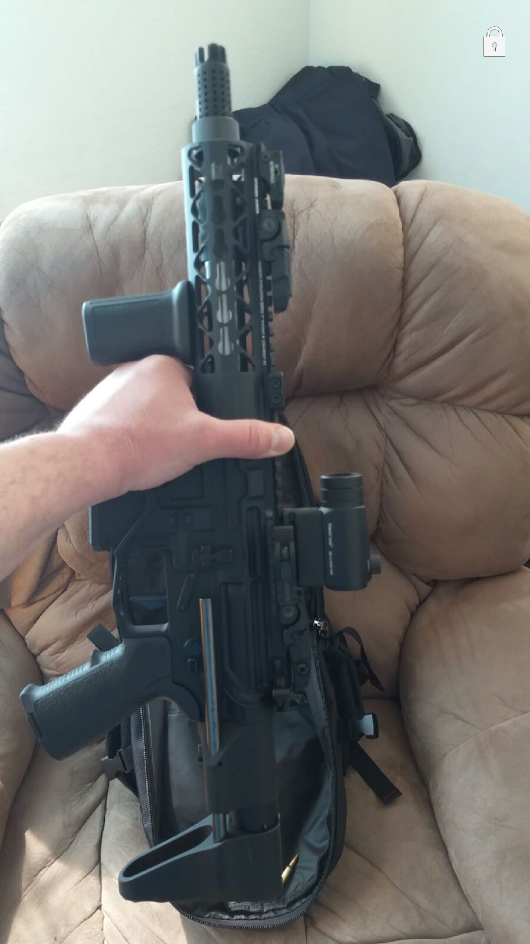
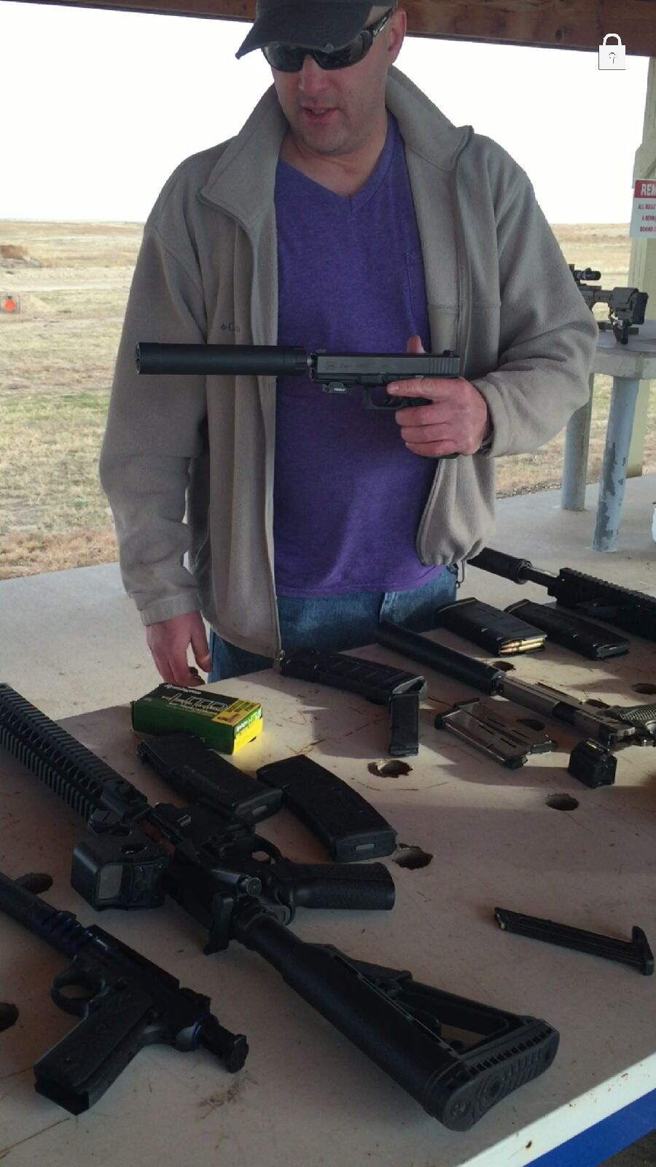
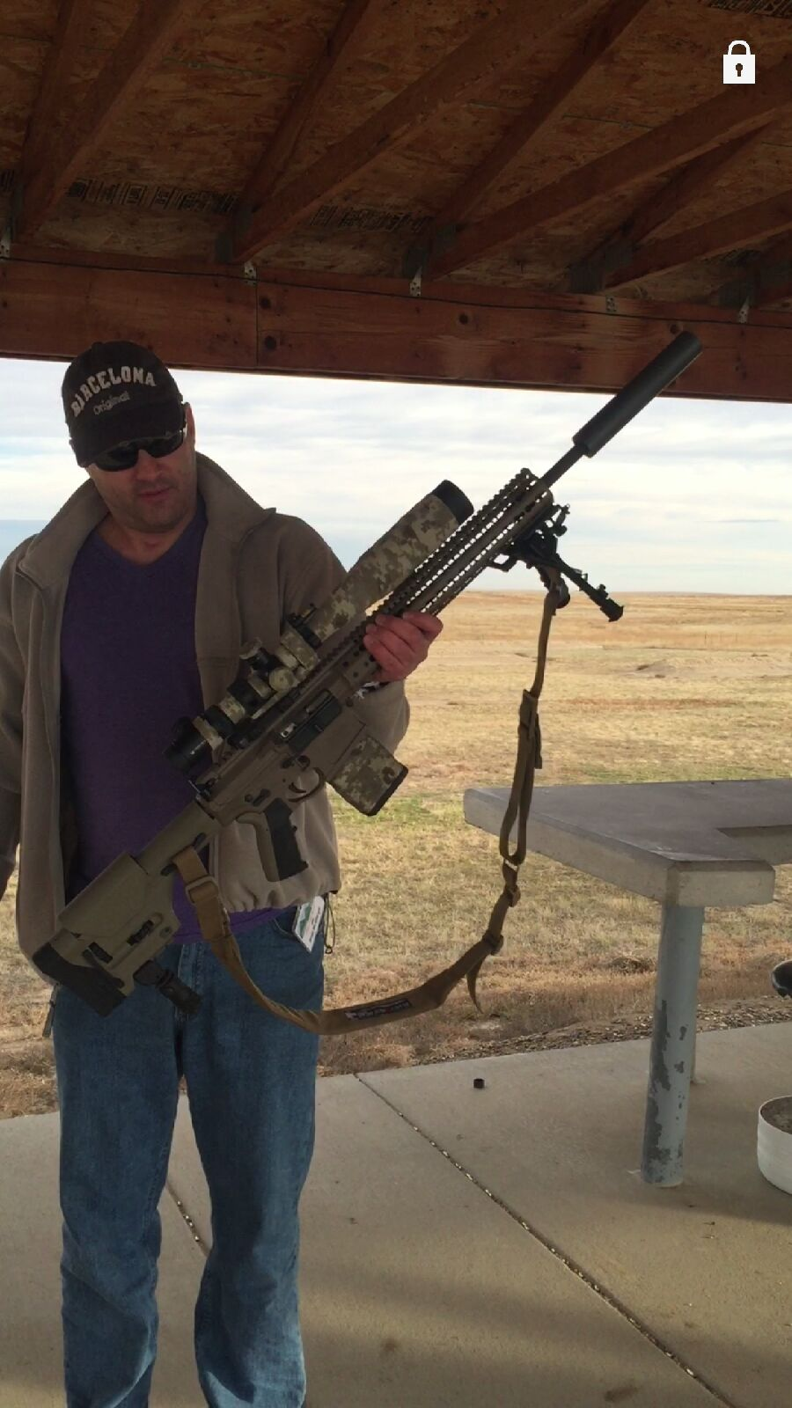

Slide 9
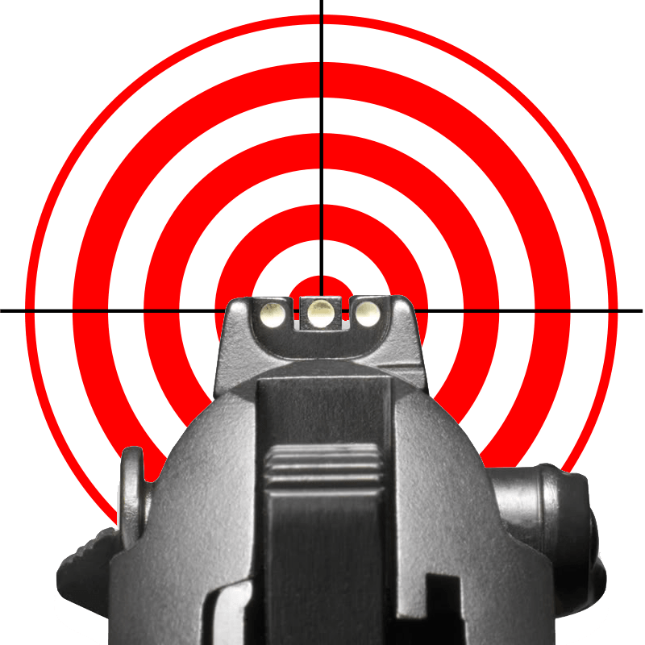
NO!! DON’T DO THIS!!!

Slide 10

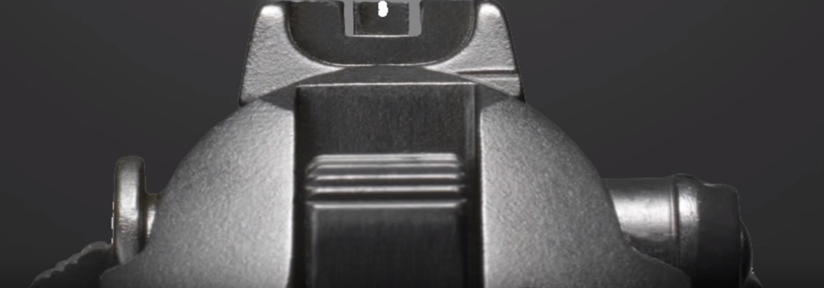

Slide 11
Let’s Get Started.

Slide 12
Getting Personal
Brian E. Brzezicki

Slide 13

FOCUS.
https://www.youtube.com/user/CenterMassGroup

Slide 14
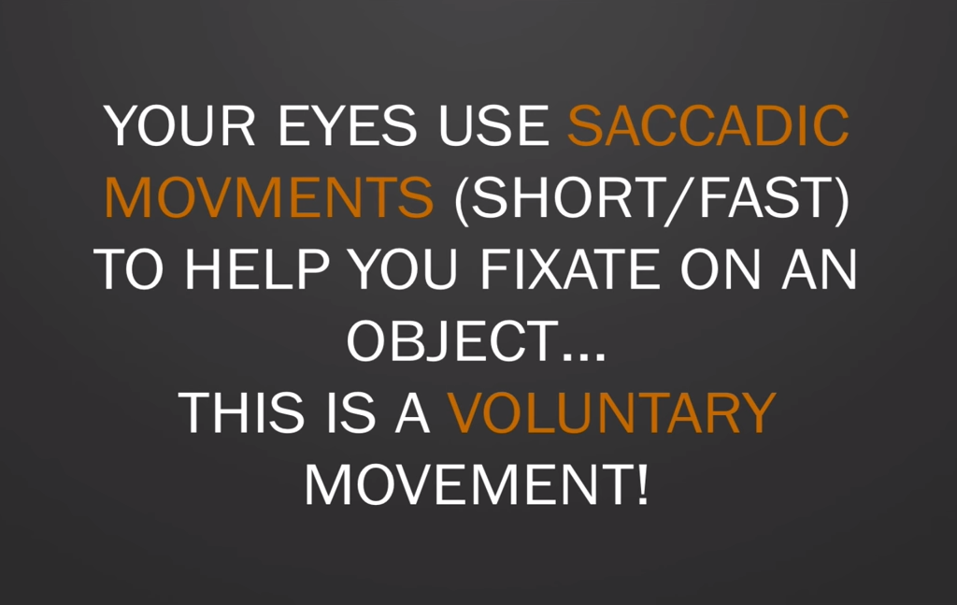

Slide 15
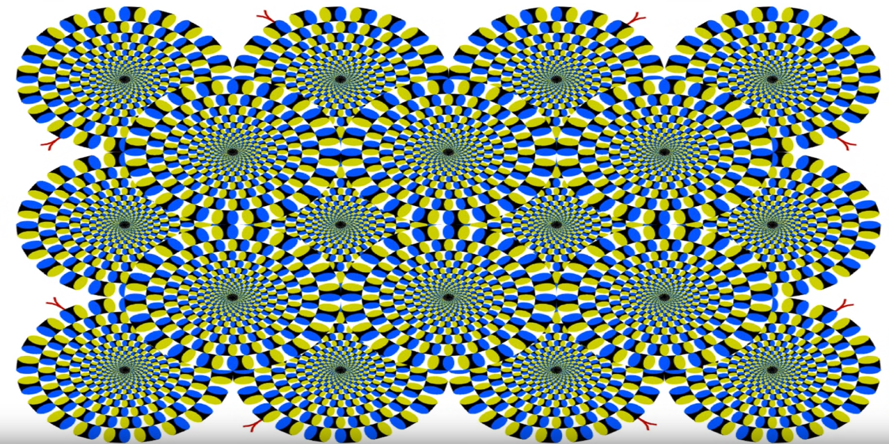

Slide 16
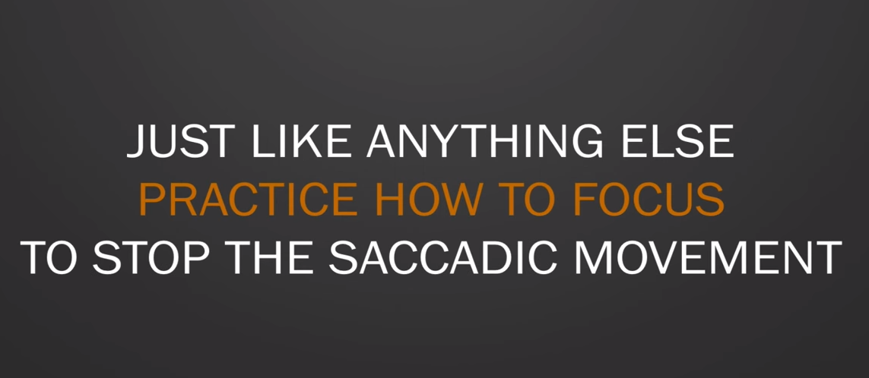

Slide 17
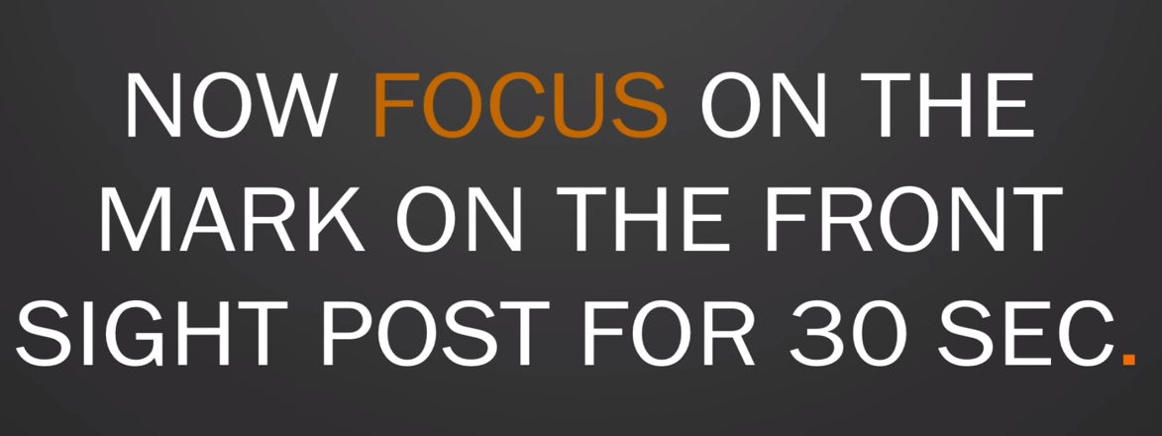

Slide 18
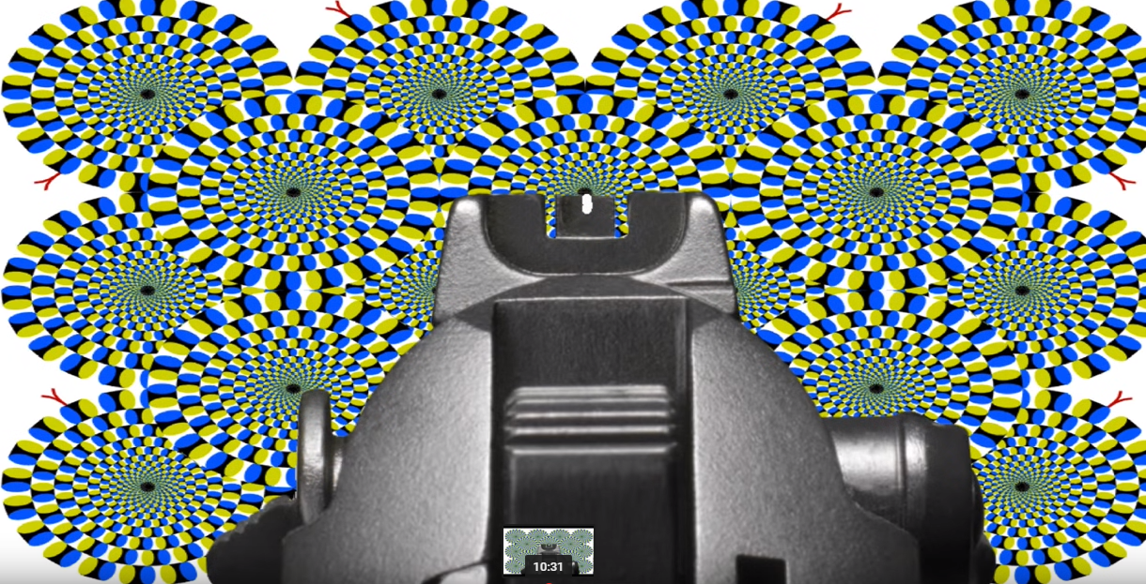

Slide 19
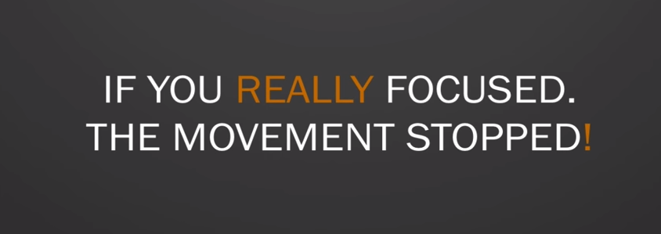

Slide 20
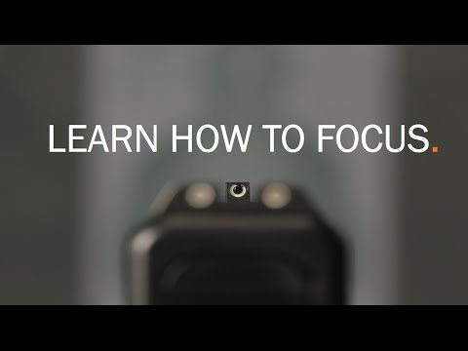

Slide 21
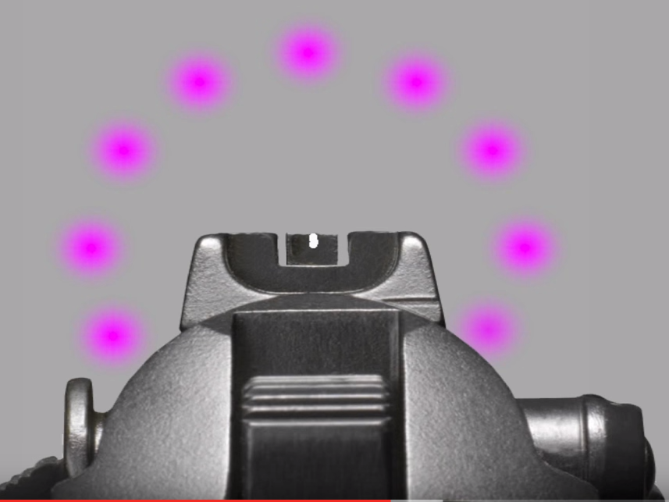

Slide 22
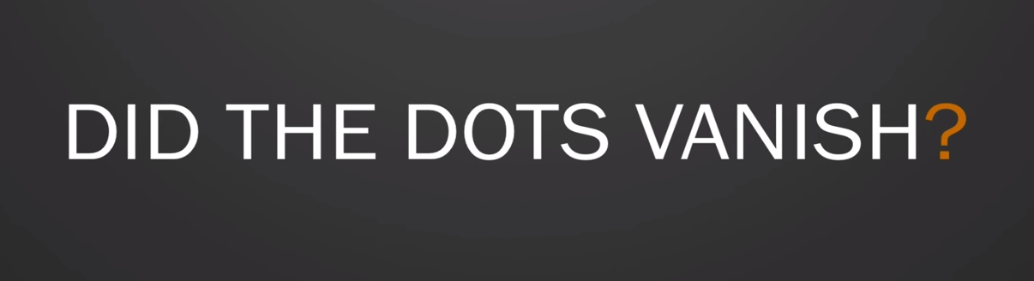

Slide 23


Slide 24
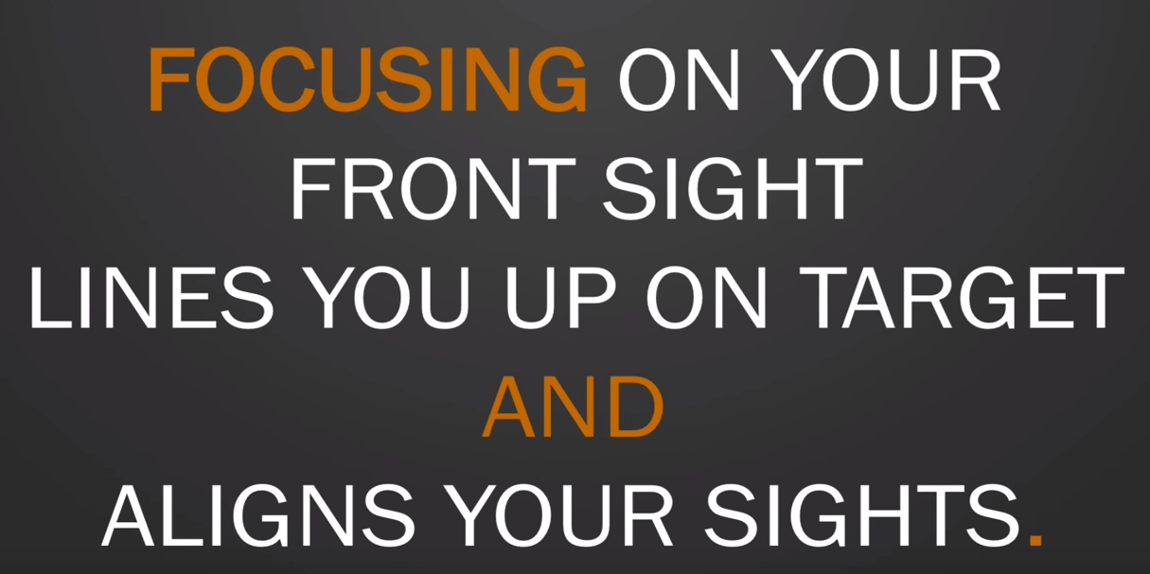

Slide 25
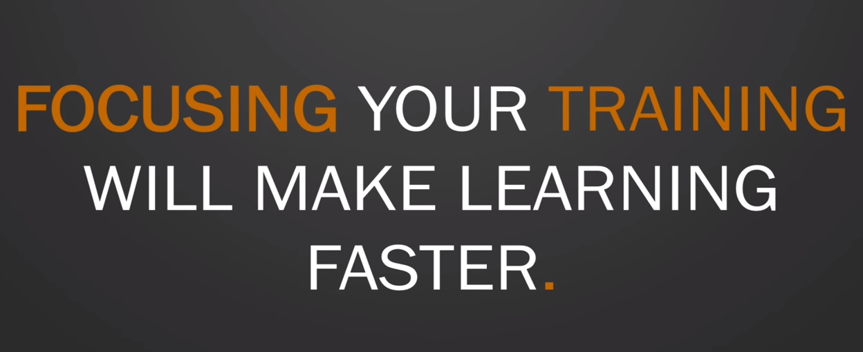

Slide 26

LIFE

Slide 27
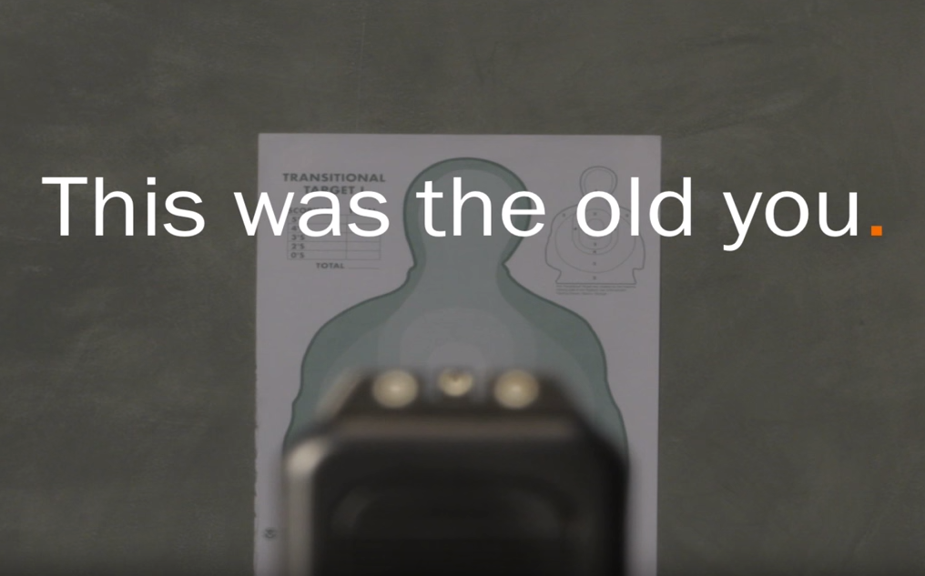

Slide 28
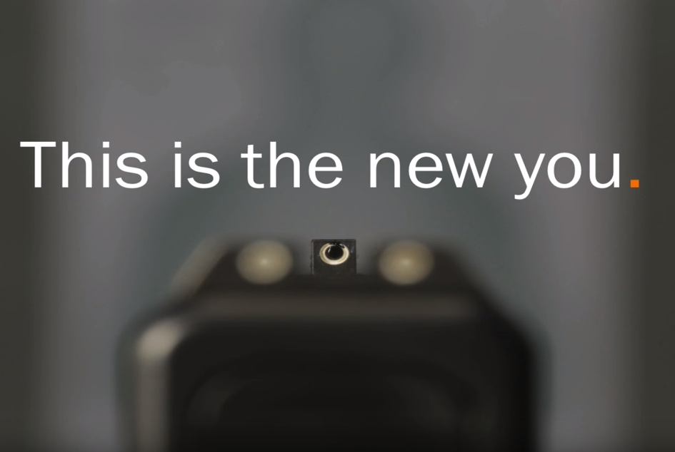

Slide 29
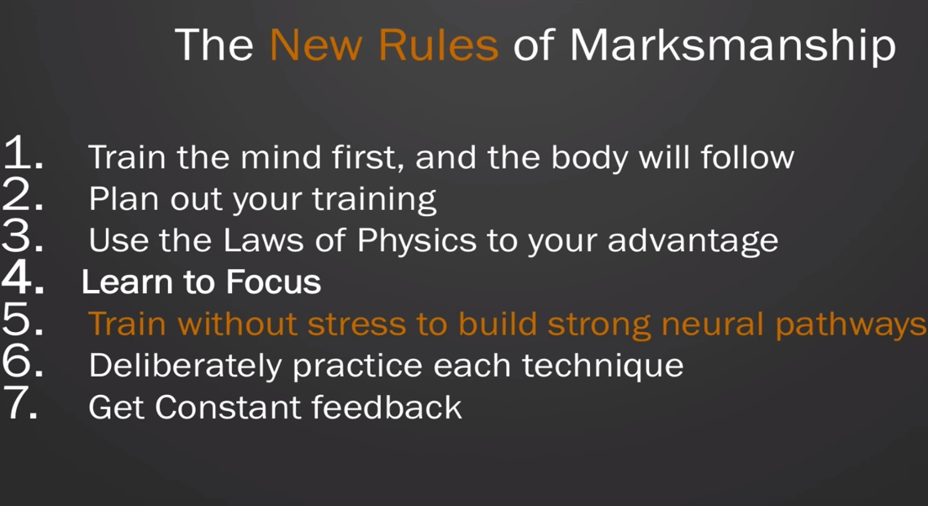
LIFE

Slide 30
Final Thoughts

Slide 31
Final Thoughts

Slide 32
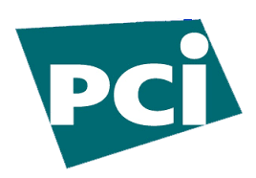



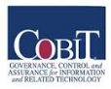
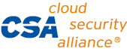


From Authorities to Audits
Examples
Technical, physical, and administrative requirements that must be in place to ensure compliance with the authorities
Statements of how a company will implement and enforce requirements
Implementation of the technical, physical, and administrative requirements found in the policy statements
Verification of appropriately implemented controls to comply with requirements
Authorities
Requirements
Gold Standard
Controls
Audits
PCI-DSS Example
Authority: PCI-DSS is the authority document created by the PCI-SSC.
Requirement: (10.6) Review logs for all system components at least daily.
Policy: Monitoring Policy – States logs will be reviewed at least daily.
Control: Tool XYZ provides real-time monitoring for all system components.
Audit: Auditor verifies Tool XYZ is appropriately monitoring and alerting to actionable events. Audit results and evidence are stored as part of the audit.

Slide 33
Effectively Managed IT Controls
Technology can affect every part of the business.
At its best, technology is a competitive advantage.
At its worst, technology is your competitor’s advantage.
Product
Market Relationships
IT Controls:
Detective, protective and reactive measures in place to protect the confidentiality, integrity, and availability of business information and ensure appropriate management of the IT function to meet business objectives.
Inbound Logistics
Operations
Outbound Logistics
Marketing
and Sales
Service
Firm Infrastructure
HR Management
Margin
Procurement
Technology Development
Notes:
Compliance Control: A process, effected by management and other personnel, designed to provide reasonable assurance that transactions are executed in accordance with 1) laws governing the use of budget authority and other laws and regulations that could have a direct and material effect on the financial statements or required supplementary stewardship information and 2) any other laws, regulations, and government wide policies identified in OMB audit guidance. [GAO/PCIE Financial Audit Manual]
Source: http://www.unifiedcompliance.com/it_compliance/language_compliance/definitions/c.html

Slide 34
Chris Davis
UTD Email: cmd140430@utdallas.edu
Google Voice: 214-771-8122
Course Materials
https://elearning.utdallas.edu

Slide 35
Additional Materials

Slide 36
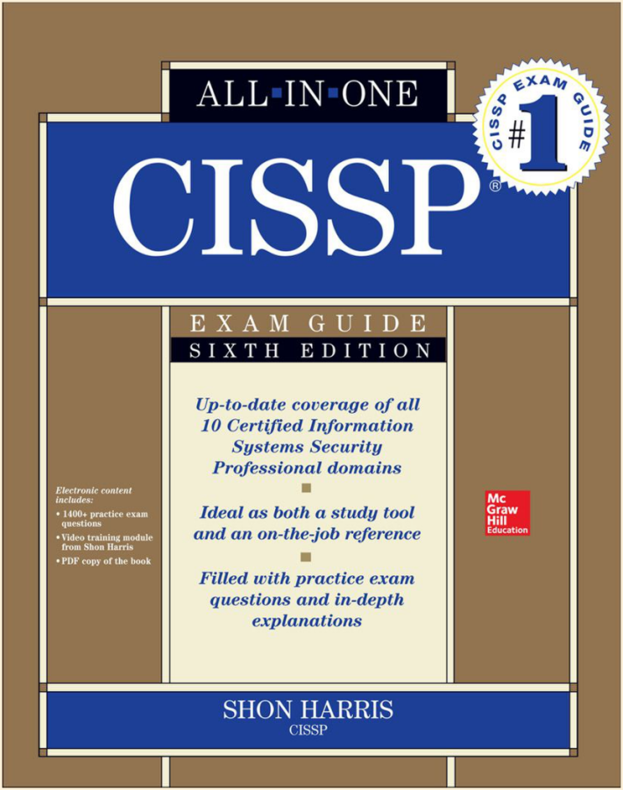
Today's Materials
Harris, Shon (2012-11-08).
CISSP All-in-One Exam Guide, 6th Edition.
McGraw-Hill Education.

